Slide 1
Al-Farabi Kazakh National University
Higher School of Medicine
Molecular and genetic basis of immunity.
Lecturer: PhD Pinsky Ilya Vladimirovich

Slide 2
LEARNING OUTCOMES
As a result of the lesson you will be able to:
1. Describe the main histocompatibility complex and its role in human immunity.
2. Explain what humoral and cellular immunity is.
3. Classify and characterize proteins involved in humoral and cellular immunity.
4. Describe congenital and acquired disorders of human immunity.

Slide 3
Literature:
1. Alberts et al, pp. 1297-1342.
2. Lodish et al, pp. 1079-1134.

Slide 4
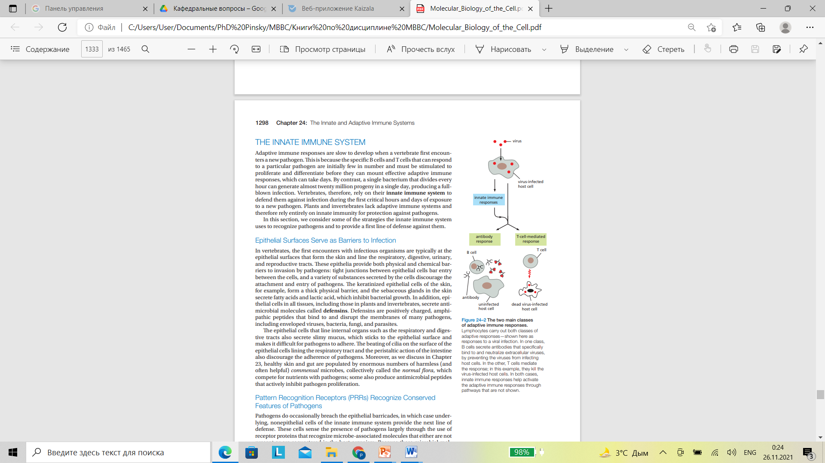
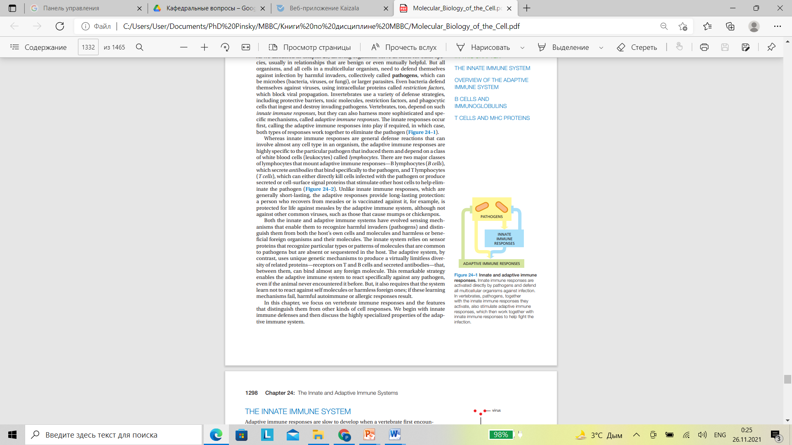

Slide 5
Proteins and signal molecules involved in humoral and cellular immunity
Complement system
Cytokines and chemokines (interleukines, interferons, prostaglandins, tromboxanes, eicosanoids, leucotriens, tumour necrosis factors (TNFs) and etc.)
Cell-surface receptors (MHCI, MHCII, TCR, etc.)
Antibodies (immunoglobulins)

Slide 6
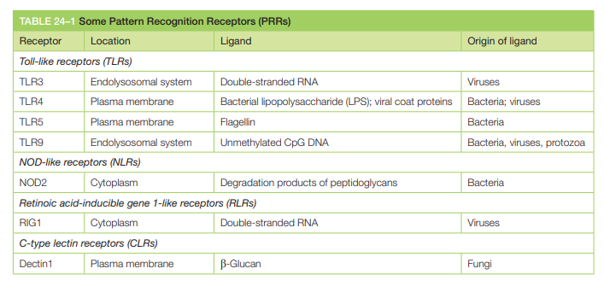

Slide 7
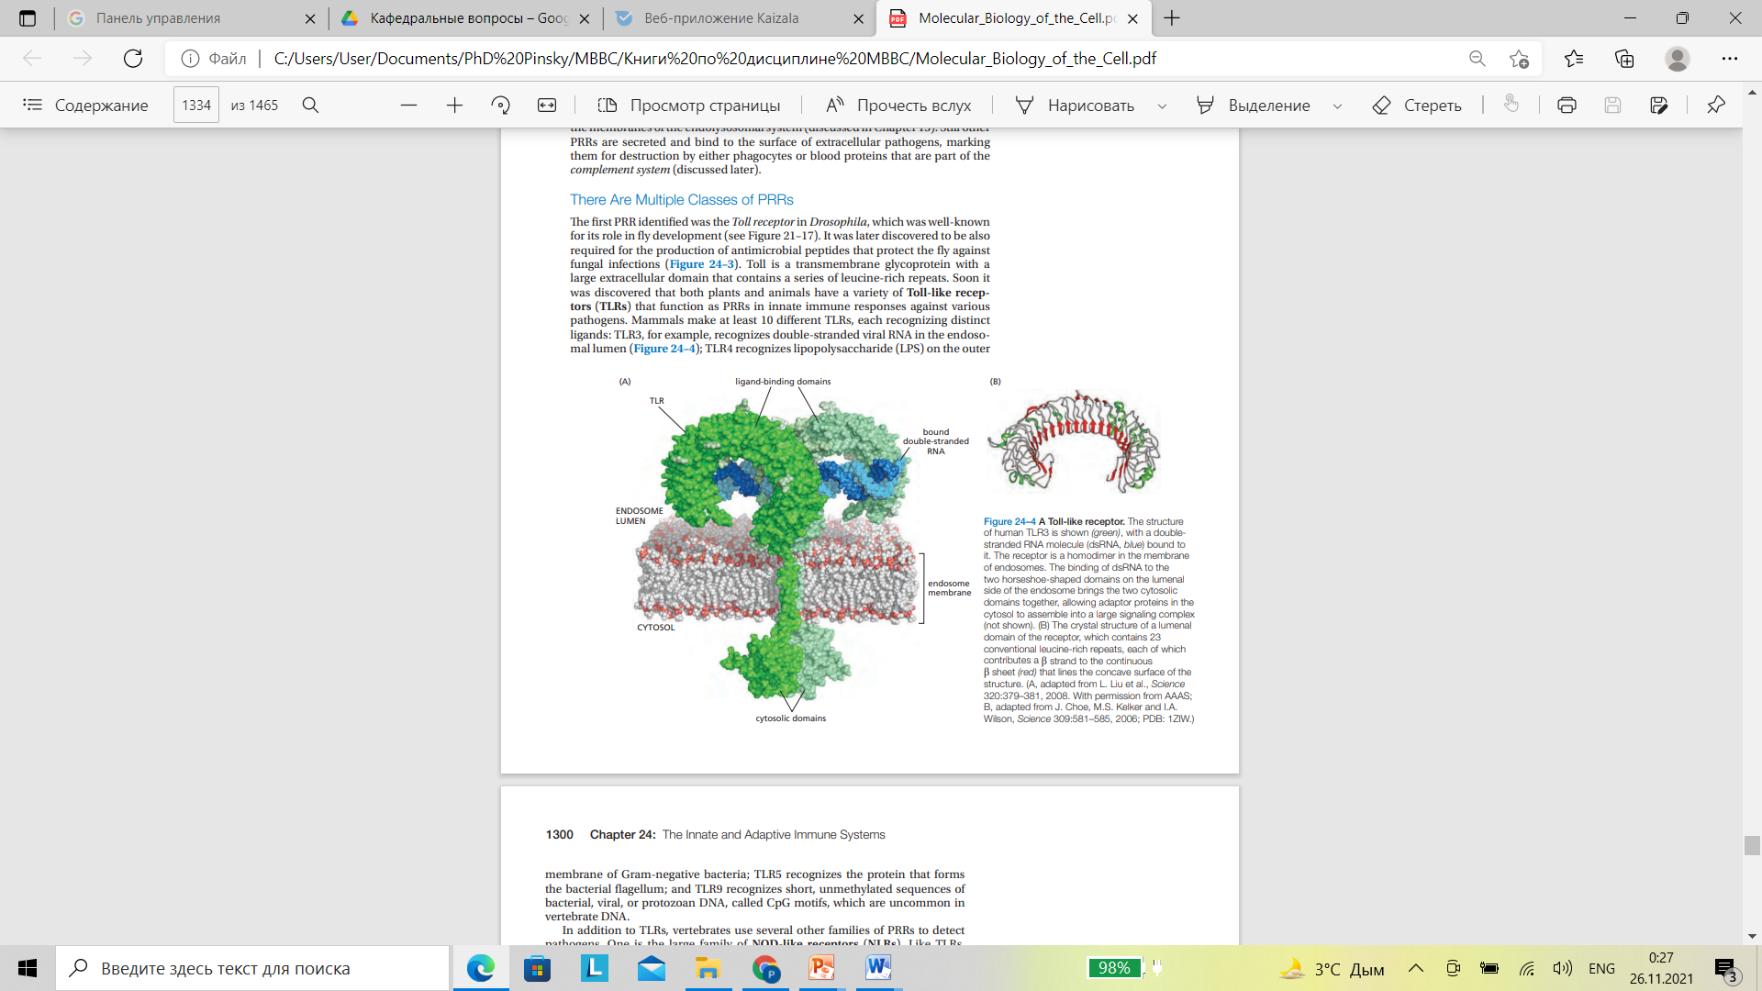

Slide 8
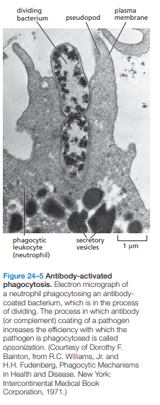
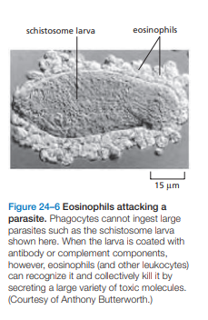

Slide 9
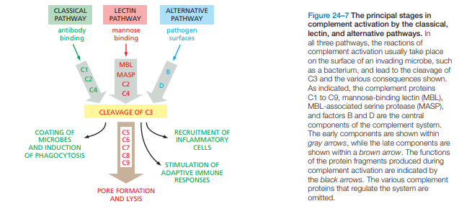

Slide 10
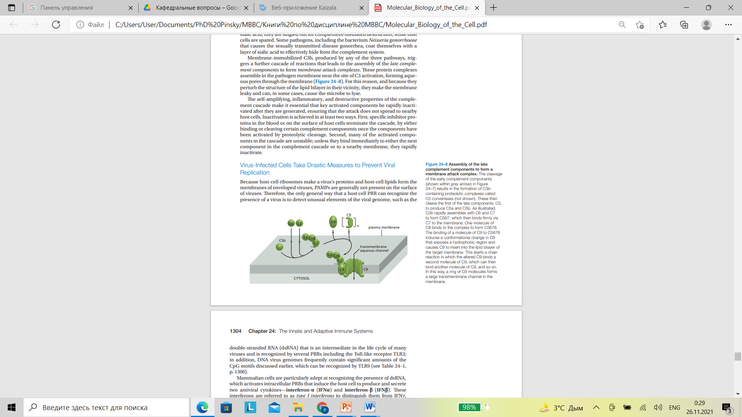

Slide 11
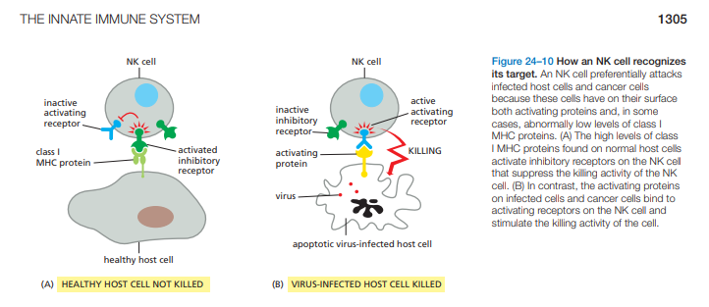

Slide 12
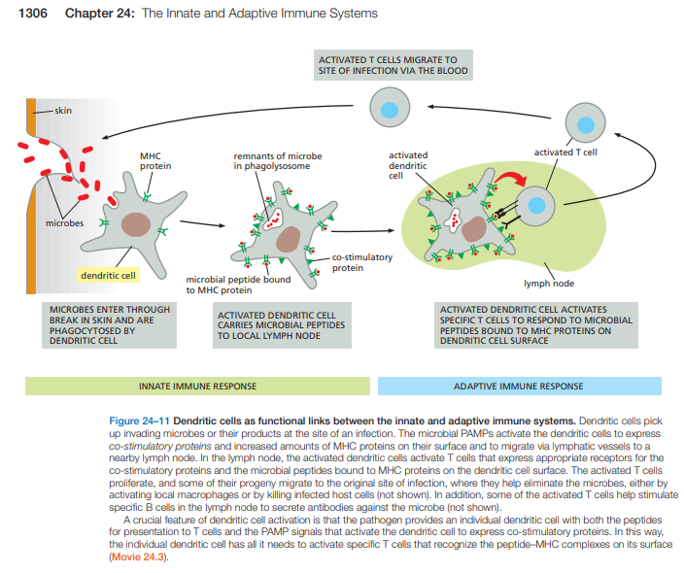

Slide 13
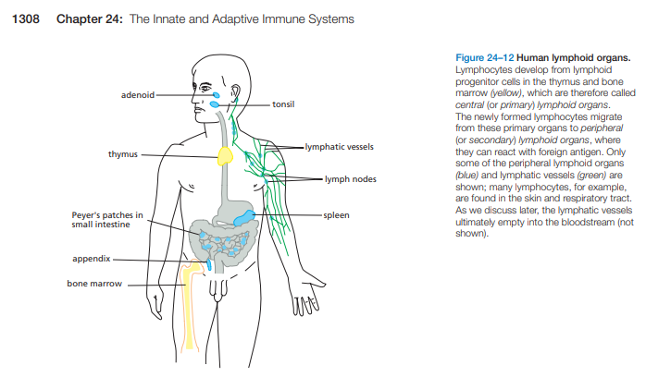

Slide 14
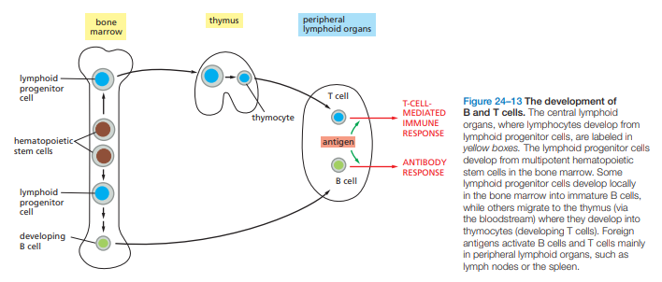

Slide 15
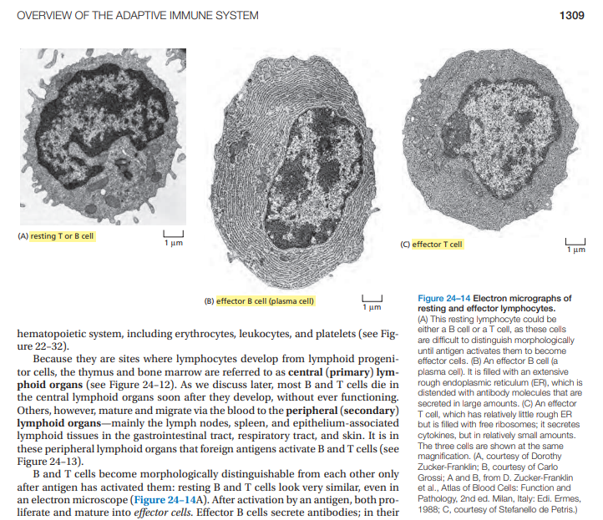

Slide 16
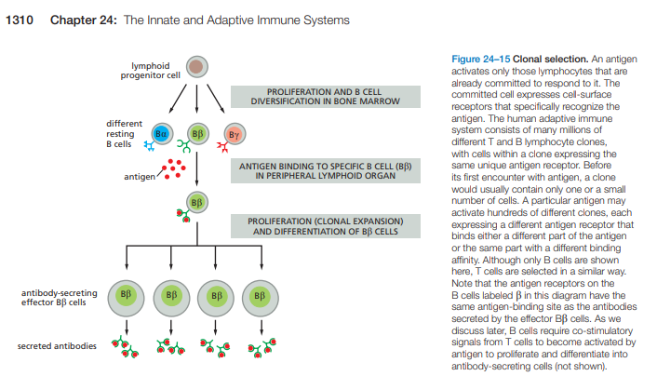

Slide 17
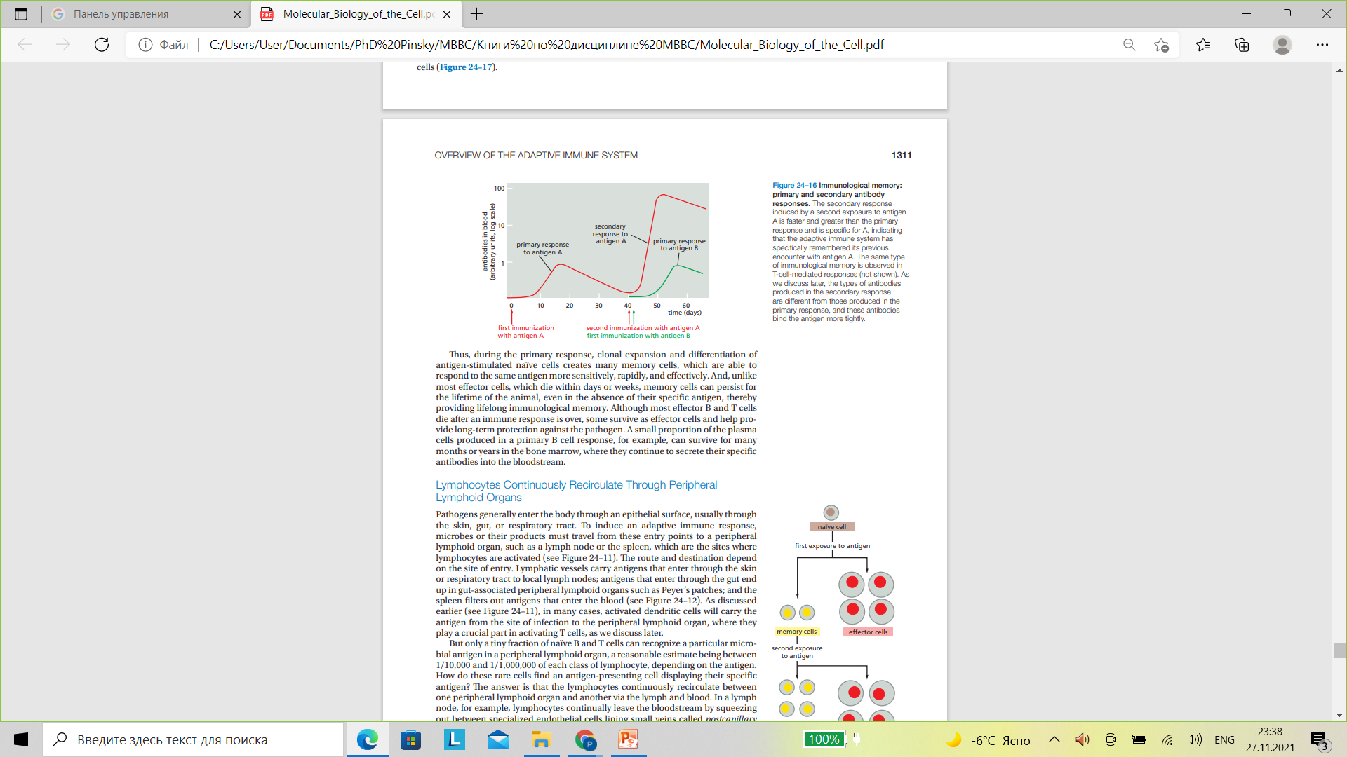

Slide 18
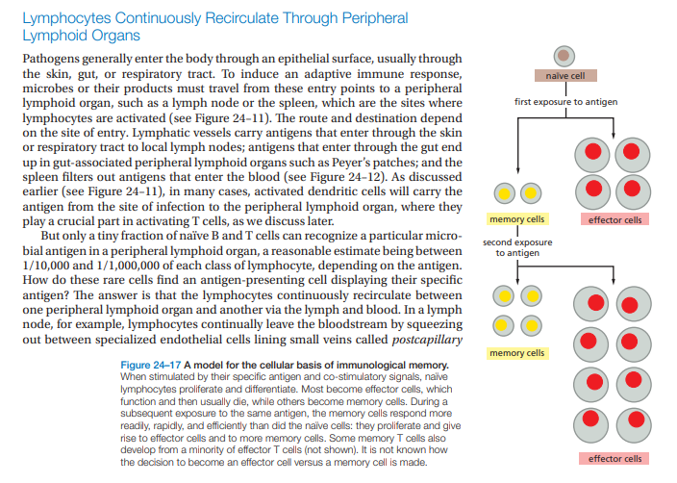

Slide 19
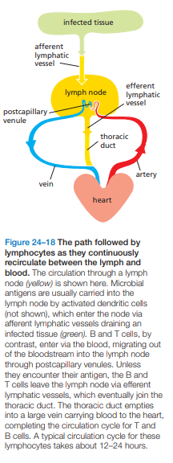
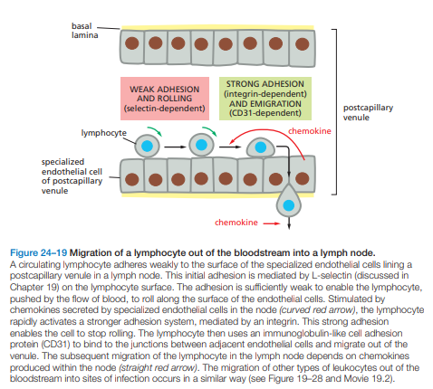

Slide 20
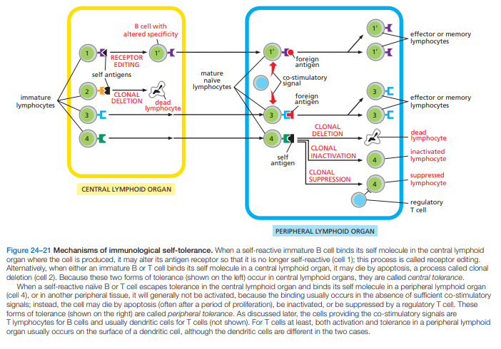

Slide 21
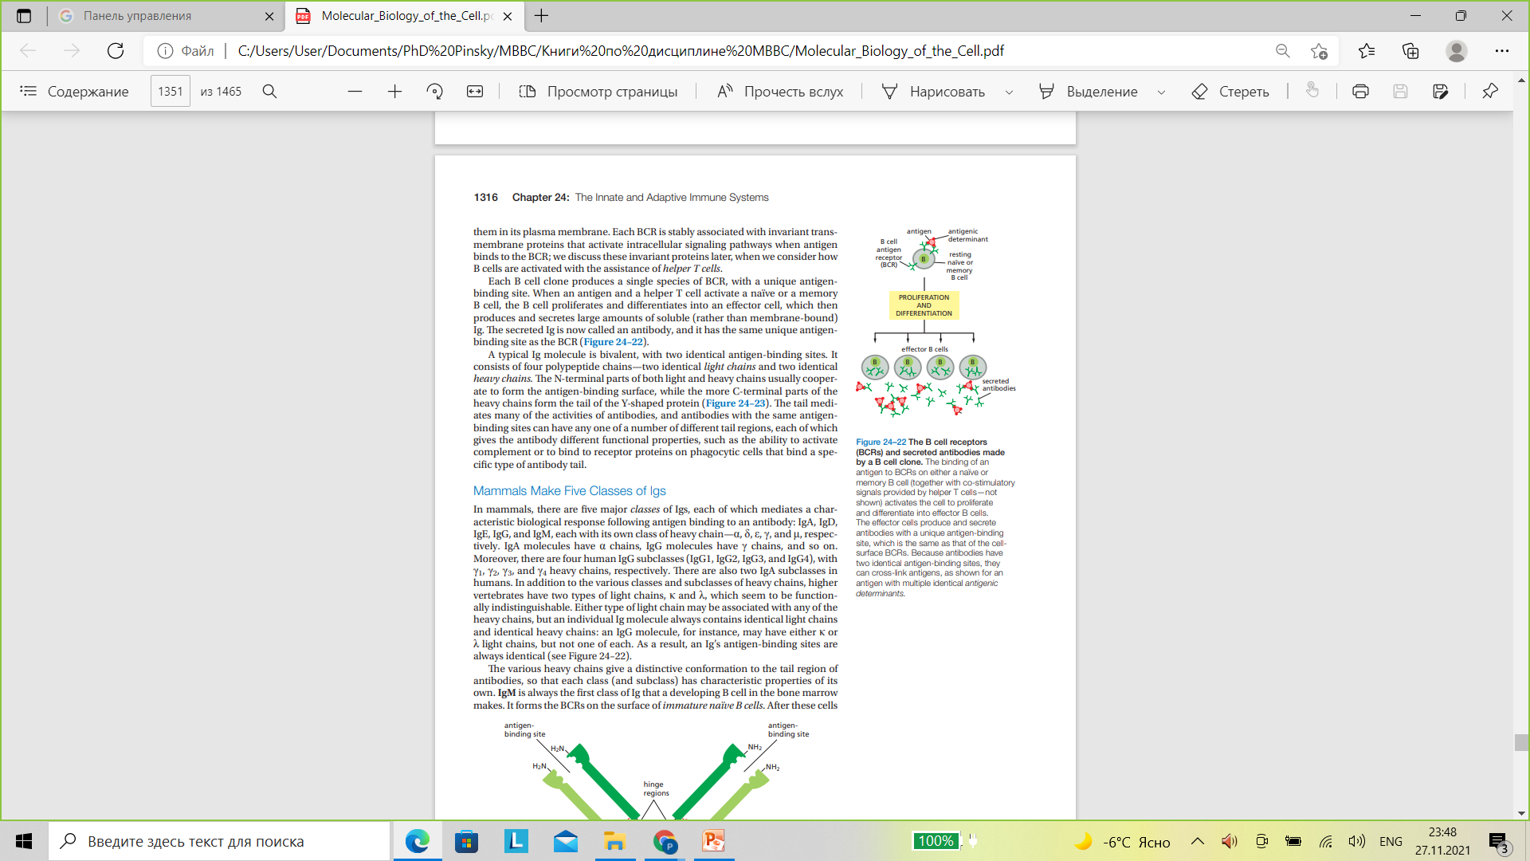

Slide 22
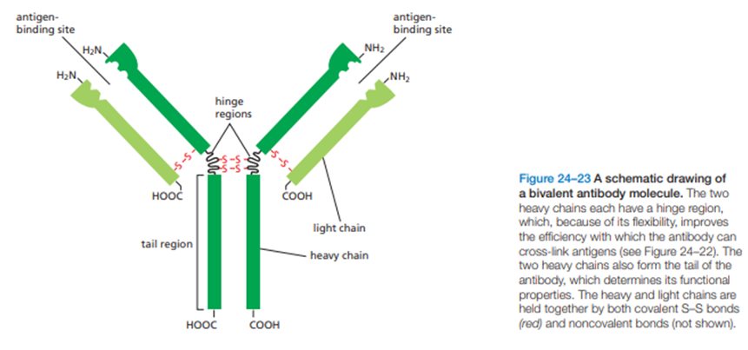

Slide 23
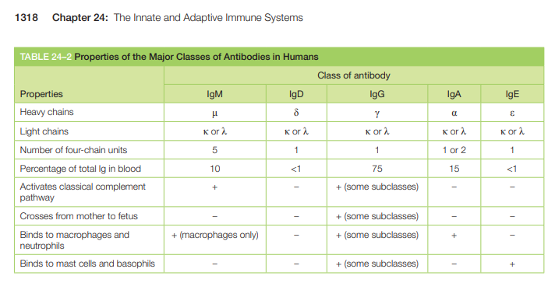

Slide 24
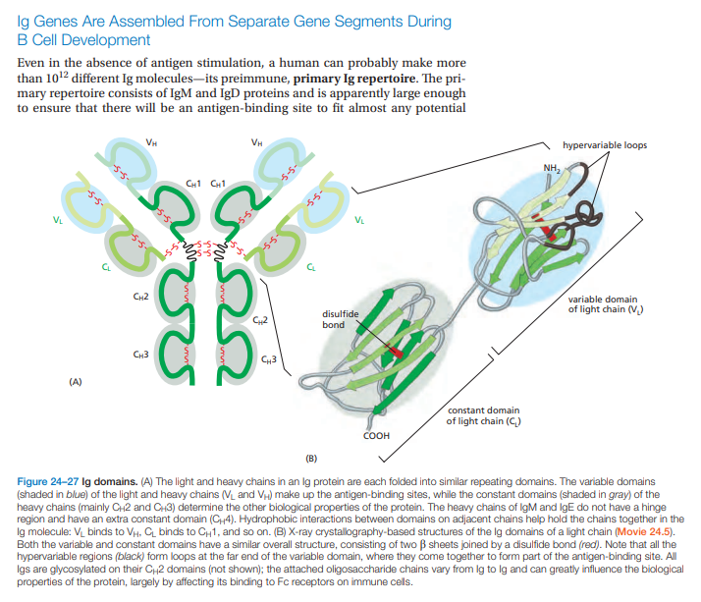

Slide 25
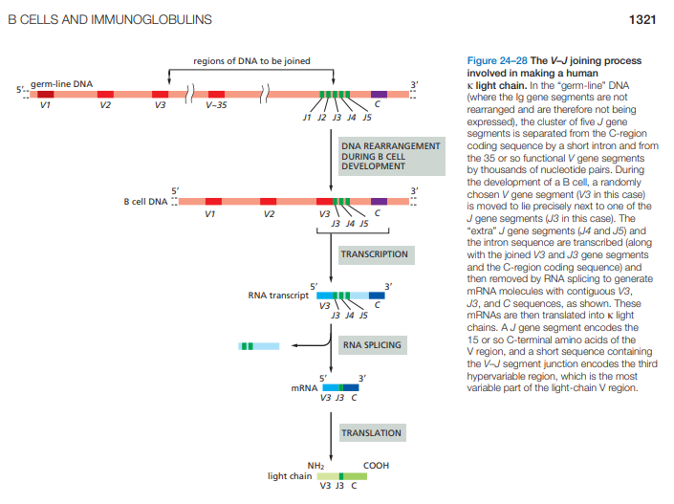

Slide 26
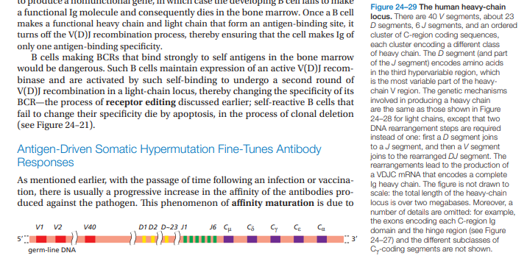

Slide 27
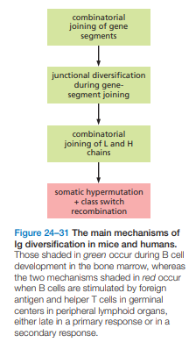

Slide 28
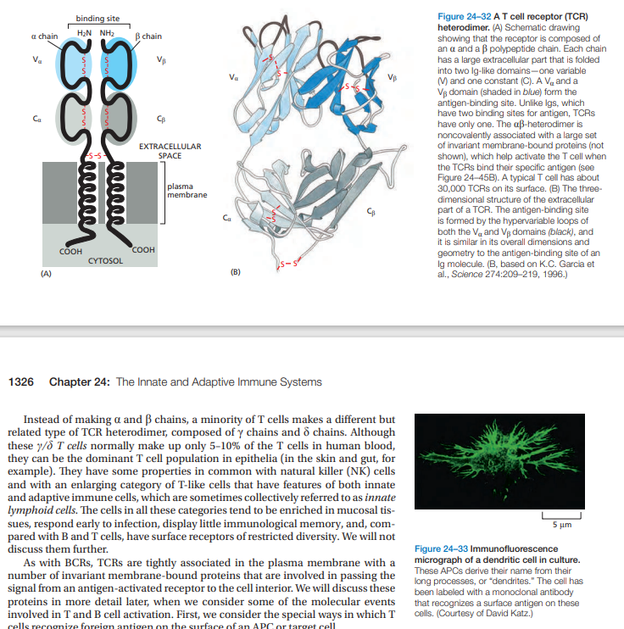

Slide 29
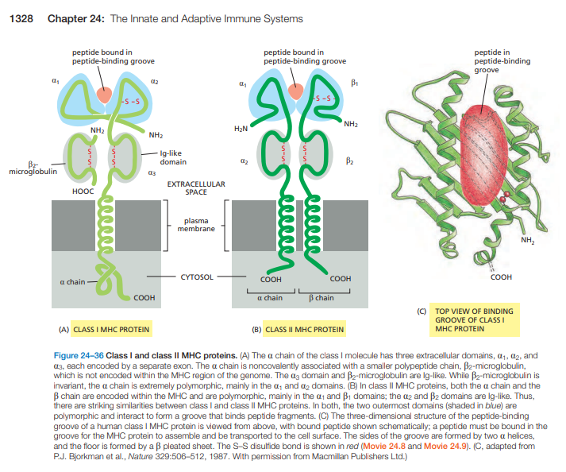

Slide 30
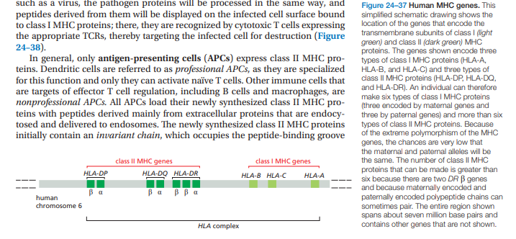

Slide 31
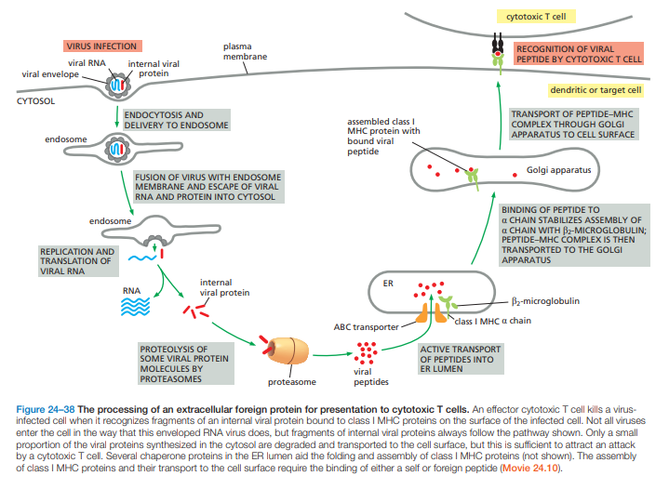

Slide 32
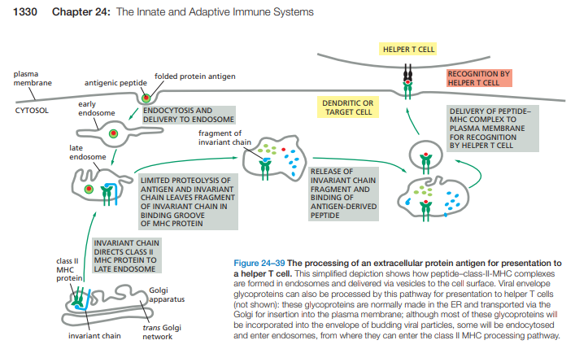

Slide 33
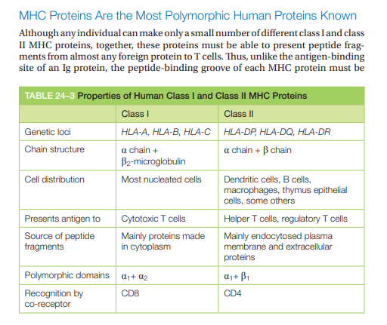

Slide 34
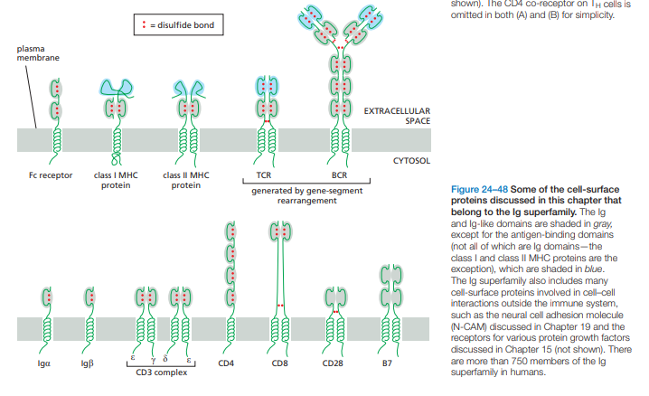

Slide 35
Disorders of human immunity
Immunodeficits (SCID, AIDS, etc.)
Autoimmune diseases
Allergic diseases

Slide 36
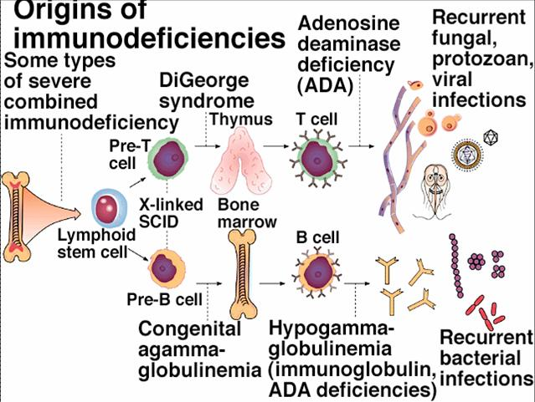
https://www.google.com/url?sa=i&url=https%3A%2F%2Funiverse-review.ca%2FR10-40-Immune.htm&psig=AOvVaw3Jieddj2VMZ97JDSzEme1R&ust=1638126096814000&source=images&cd=vfe&ved=0CAwQjhxqFwoTCNDClLSdufQCFQAAAAAdAAAAABAZ

